Slide 1
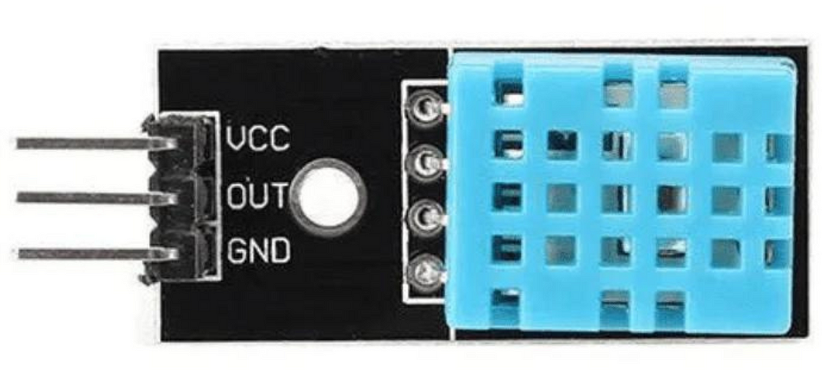
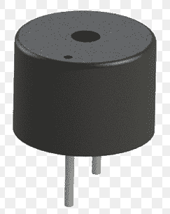
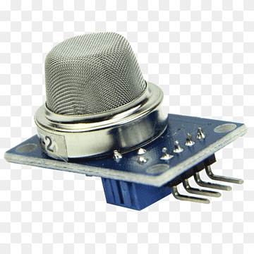
3. Temperature & Humidity Sensor:
4. Buzzer:
DHT11 Sensor is a versatile and affordable device that accurately measures both humidity and temperature. Ideal for various applications, from smart homes to weather monitoring systems, it provides reliable data for improved automation and environmental control.
The piezo, also known as the buzzer, is a component that is used for generating sound. It is a digital component that can be connected to digital outputs, and emits a tone when the output is HIGH.
5. Gas Sensors:
A gas sensor is a system that senses the presence or concentration of gases in the atmosphere. By changing the resistance of the material within the sensor in response to the gas concentration, the sensor generates a corresponding potential difference, which can be calculated as output voltage.

Slide 2
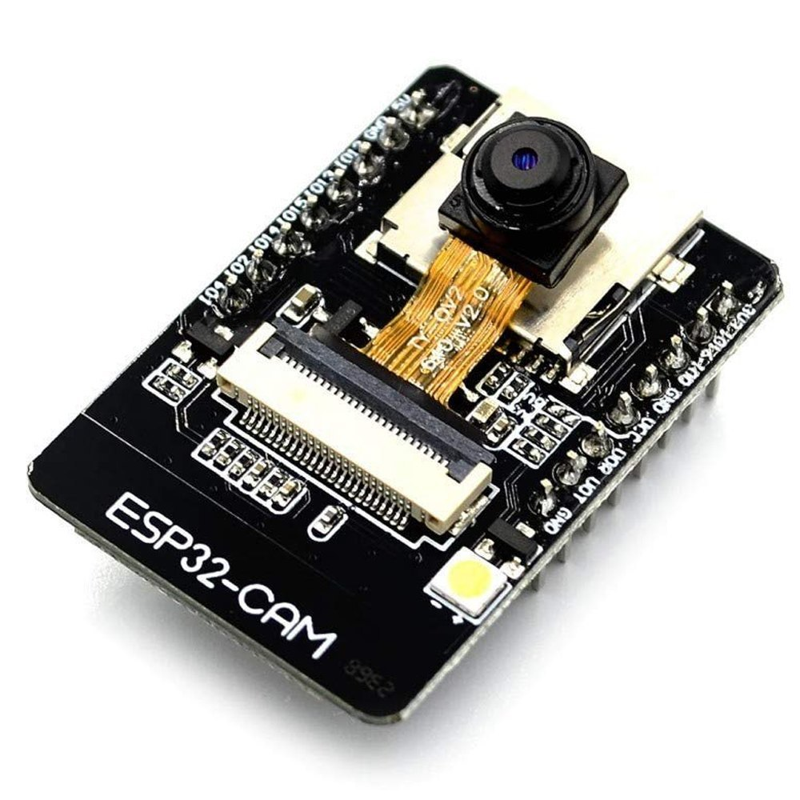
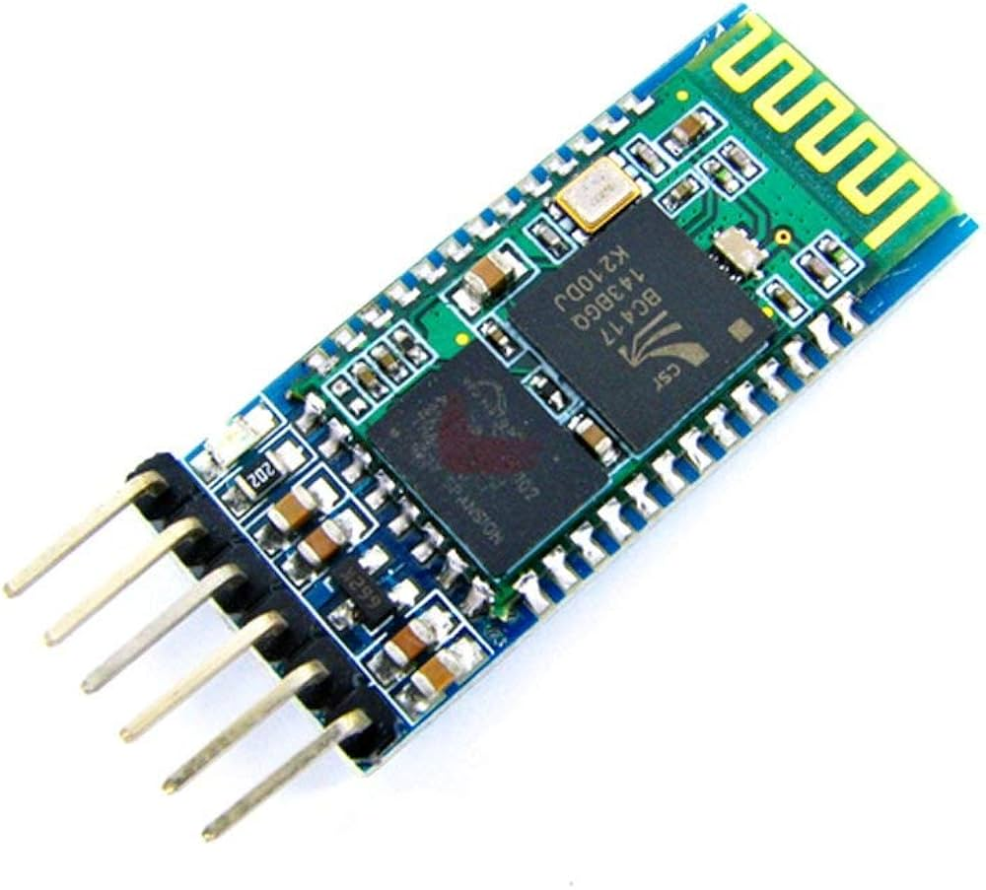
6. ESP32-CAM:
7. OLED Display:
The ESP32-CAM is a development board based on the ESP32 chip that incorporates a camera module, Wi-Fi, and Bluetooth connectivity, making it suitable for various IoT applications requiring image capture and data transmission.
The OLED Display displays the required parameters.
8. Bluetooth Module (HC05):
The HC-05 is a widely used, compact Bluetooth module enabling wireless serial communication (UART) between devices, operating on Bluetooth 2.0 technology with Enhanced Data Rate (EDR) support and a range of about 10 meters.

Slide 3
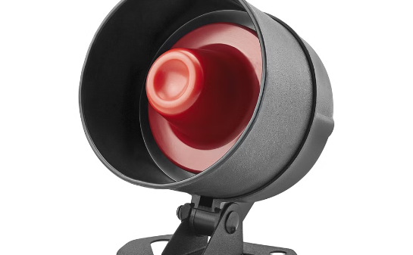
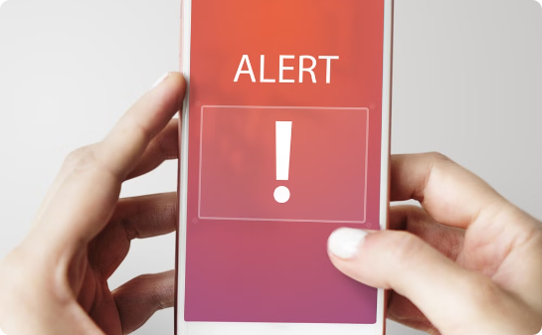
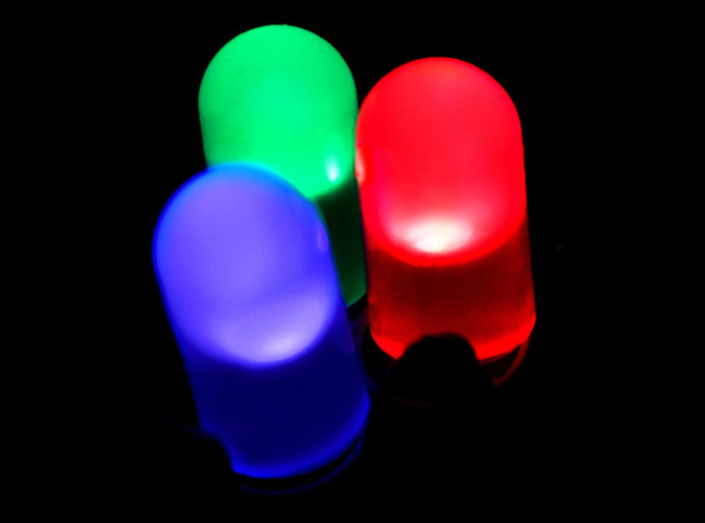
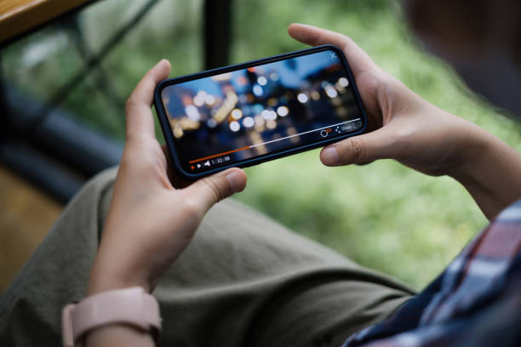
Alert Mechanisms:
Audio Alarm
Mobile Alerts
A loud siren provides a traditional and effective way to alert occupants of a potential fire.
The system can send alert calls and notifications to smartphones, alerting occupants even when they are away from home.
Visual Alarm
Live Video
Red LED lights can be used to alert individuals who may be hard of hearing or unable to hear the audio alarm.
The system can send live video footage wirelessly to the outside workstation

Slide 4
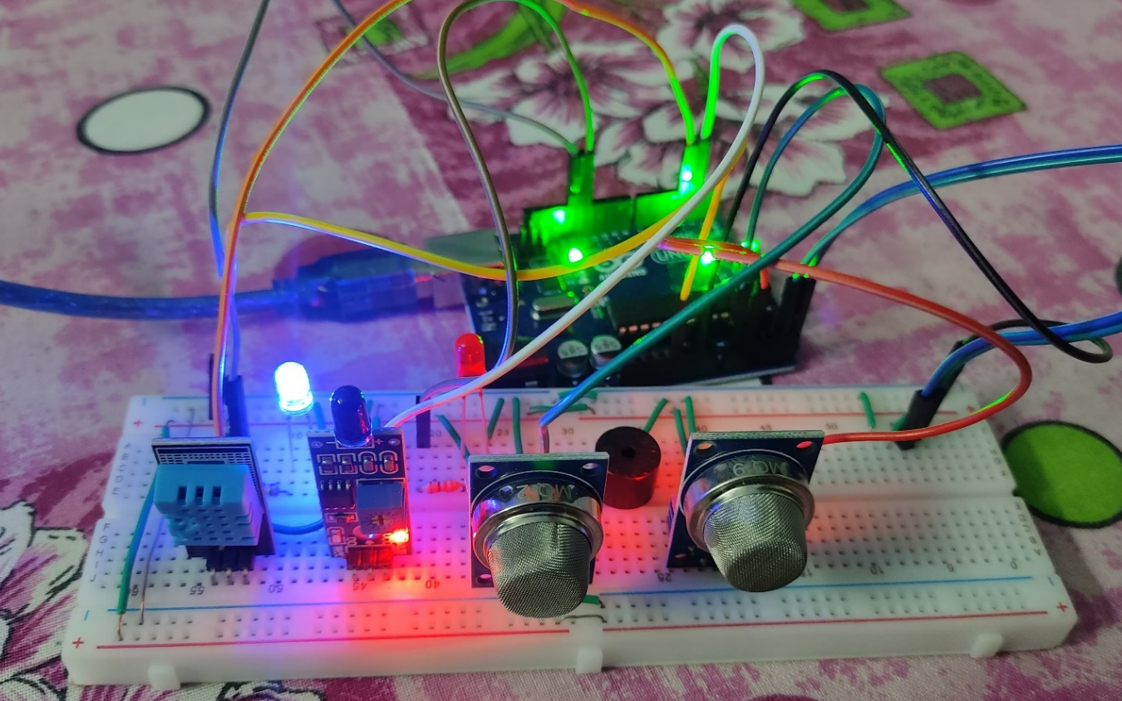
Work till now:

Slide 5

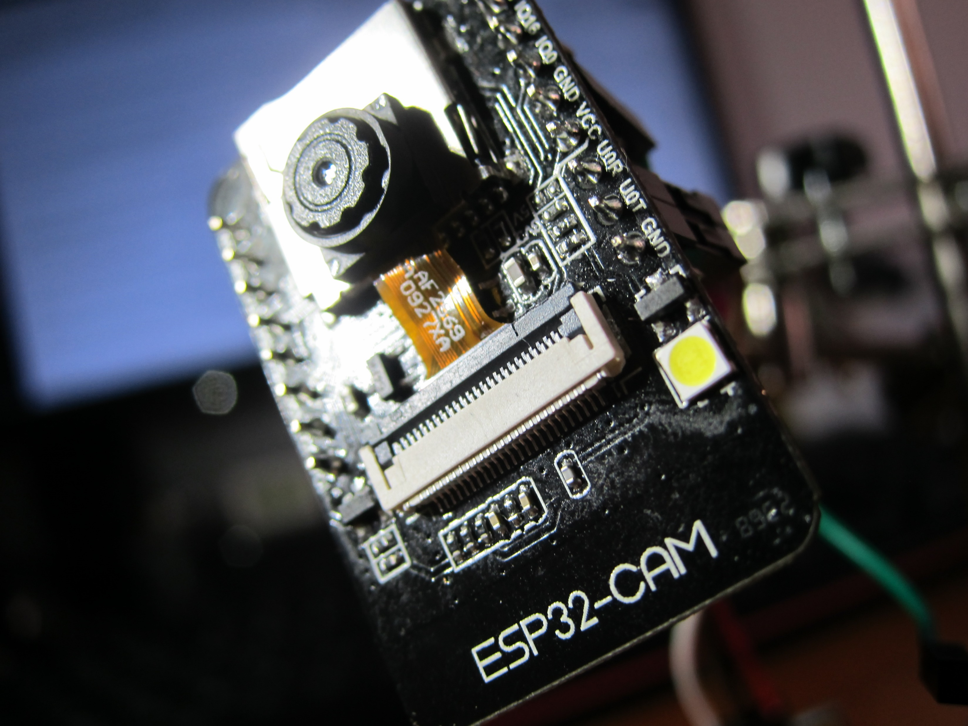
Pending:
1
Implementing ESP32-CAM
Connecting the Communication Module
2
3
Establishing the system

Slide 6
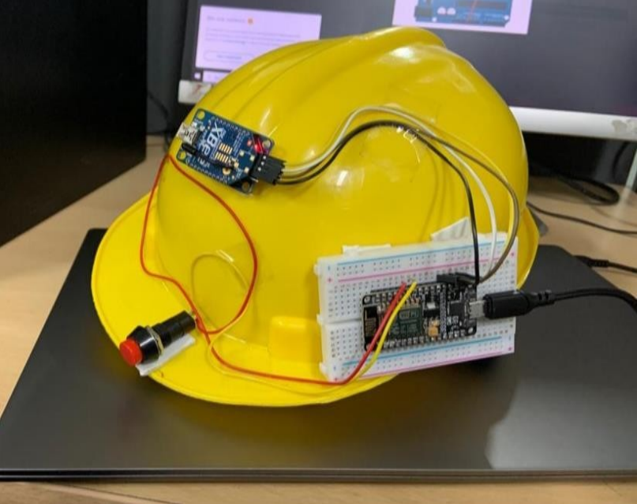
Proposed System:

Slide 7
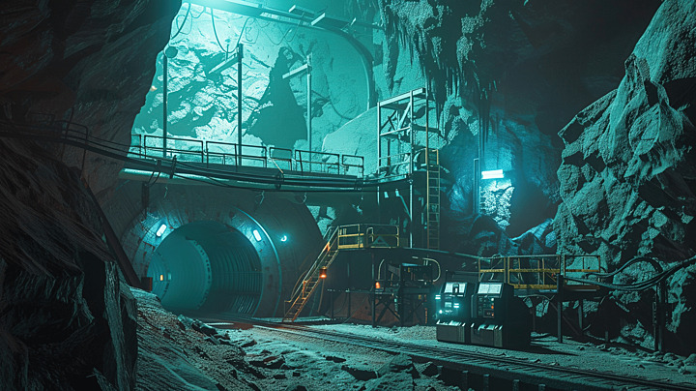
Applications:
1
Mine Worker Safety
Detects hazardous gases, extreme temperatures, and flames, alerting workers in real time through buzzers, LEDs, and GSM messages to prevent accidents.
2
Industrial & Research Applications
Can be adapted for use in tunnels, oil refineries, chemical plants, and other hazardous environments where real-time monitoring and alerting are crucial.
Disaster Prevention & Early Warning
Identifies dangerous environmental changes early, such as gas leaks or fire outbreaks, allowing prompt evacuation and risk mitigation.
Remote Monitoring & Surveillance
The infrared camera provides live video transmission to external workstations, enabling remote monitoring of mine conditions and enhancing safety oversight.
3
4

Slide 8

The Smart Miner Helmet enhances mine safety by continuously monitoring environmental conditions such as gas levels, temperature, humidity, and flames. With real-time alerts through LEDs, buzzers, and Bluetooth modules, along with an infrared camera for live video surveillance, the system provides a reliable and efficient solution for preventing accidents and ensuring worker safety. Its adaptability for various industrial applications makes it a valuable tool for hazardous environment monitoring and risk management.
Conclusion:

